Slide 1
A Roadmap for PhD Applications
Aalhad
Amlan
Pravita
Smriti

Slide 2
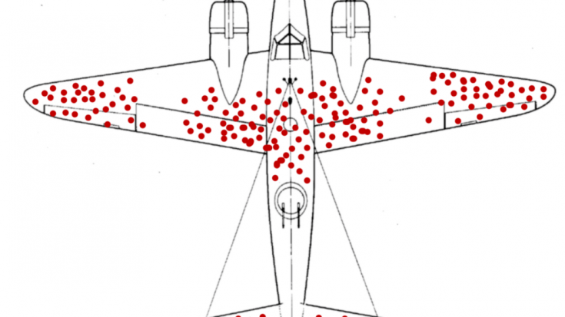
Guidelines, not Rules

Slide 3
Why PhD?
?

Slide 4
Why USA?
Rotations
Flexible Research
Longer and Rigourous PhD
Coursework
More money on an average
Networking
Easy to travel to other countries
Student Discounts

Slide 5
Why not USA?
Guns
Healthcare is costly
Public Transport outside of certain major cities and university towns is bad
Flights are expensive + time difference
You are not an employee
Visas are more painful
More expensive
More competitive
Very location specific
https://en.wikipedia.org/wiki/Red_states_and_blue_states
https://www.phdstipends.com/

Slide 6
How to pick schools?
To be safe, apply ~10-15 places*:
https://en.wikipedia.org/wiki/List_of_research_universities_in_the_United_States
Use tier lists: Safeties, Competitive, Reach
Good Fit
Do not apply to only top 10 places
At least 2 POIs
Ask your PI and recommenders
Go through conference listings
*if you can afford it
Common open houses (APS Biophysics Virtual Open House)
https://www.thegradcafe.com/
r/gradadmissions
Where will you be living?
Check for grants
Websites (AAS job register)
Minimum guaranteed funding

Slide 7
Can you afford it?
~$80 per place (can be waived)
TOEFL $195 + $20
GRE ($228 + $30) + Subject GRE ($150 + $30)
See if you need to give it
https://docs.google.com/spreadsheets/d/19UhYToXOPZkZ3CM469ru3Uwk4584CmzZyAVVwQJJcyc/edit#gid=0
Make full use of IISER codes
Ask if they really need it
Score reviews ($100+)
Mostly optional

Slide 8
Your profile
CV
CPI
Test Scores
LoRs
SoP
Other statements

Slide 9
CV
Mention it is a CV with your name
Put relevant information
Don’t put irrelevant information

Slide 10
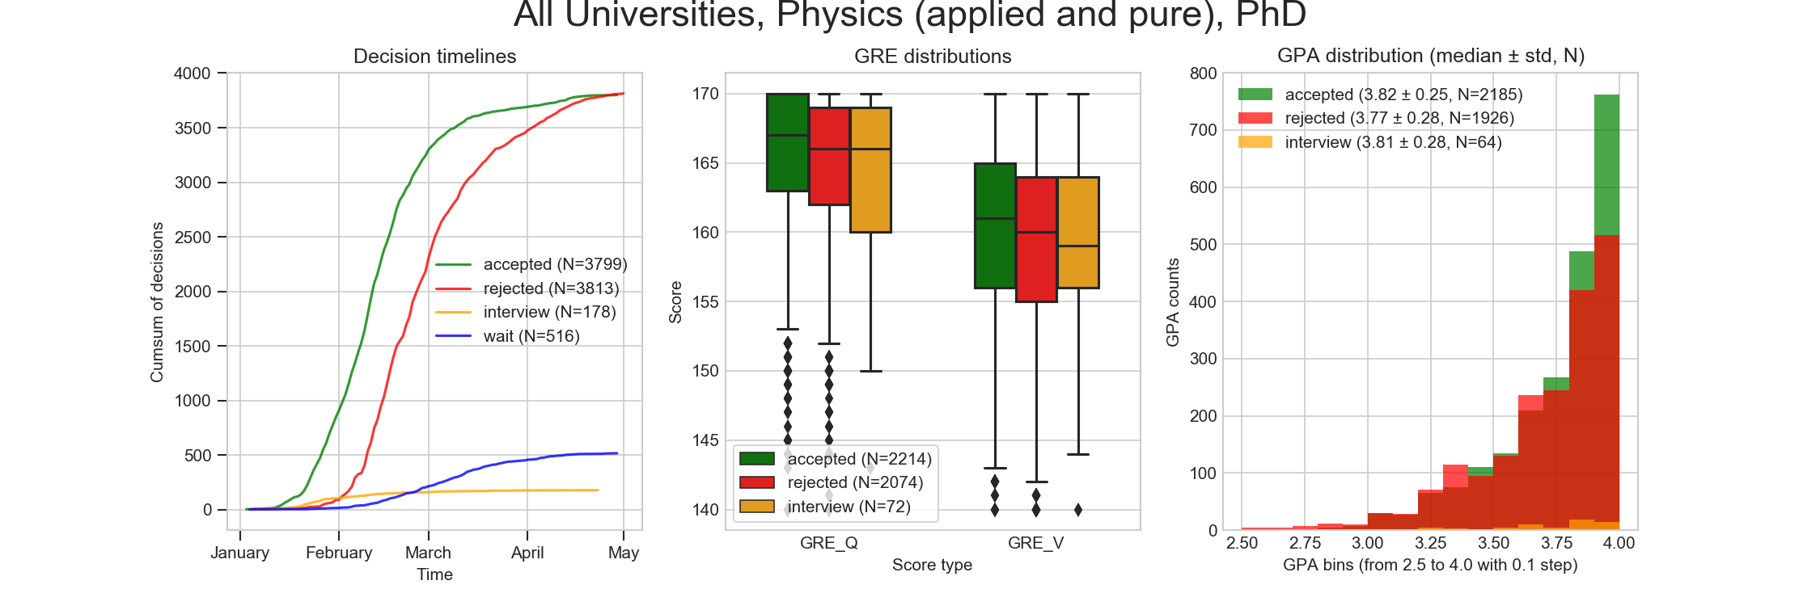
CPI
Needs to be ¾ or 7.5/10
Major CPI can also play a role
Very top places do want high CPI
https://imgur.com/a/35tTy
CPI has a logarithmic payoff
Needs to be above ¾ (7.5/10)
https://m.imgur.com/a/35tTy

Slide 11
Test Scores
TOEFL: Mandatory
GRE: Don’t give
Subject GRE:
Mostly don’t give it
Give it if it helps your CPI
Give it if you’re going for pure theory

Slide 12
LoRs
Most important!
Most places need 3 LoRs
1 should be masters thesis guide
Can be helpful to have someone from IISER (who you’ve taken courses with)
Can be a postdoc
Help them help you
Ask them to tailor the LoR
Give them time
Strong LoR from ok person >> generic LoR from big person

Slide 13
SoP – what to do
Write a Personal SoP
Use “I”
Use positive language
Talk about the school
Follow their directions and prompts
Be direct and exact
For research work, give them the main results
Talk about skills and techniques
Show, not tell
Be specific about why you are interested in a PI
Future goals
Proofreading!

Slide 14
SoP – what not to do
Don’t make grammar mistakes
Don’t include false statements
Don’t start last minute
NO CHILDHOOD STORIES
Avoid overly flowery or complex language
Don’t explain their research to them
Don’t exceed the word limit
No jokes
Don’t blame others
Don’t try to gain sympathy
Don’t mention coming back to India

Slide 15
Other statements
Diversity Statements
Developing country
Gender/Caste/Sexuality etc
Pandemic
Lack of access
Contributions to diversity
Personal Statement
Community Service
Leadership
Outreach
Motivation

Slide 16
Cold Emailing
DO IT
Start with collaborators
Can help applications
Increases confidence
Helps with availability – can help with choosing
You can also email after submitting the application
Figuring out exactly which department to apply to
You should email their PhD students

Slide 17
Any further questions?
Aalhad
9599809675, ms18118@iisermohali.ac.in
Amlan
8456939278, amfcb2010@gmail.com
Pravita
9172994592, pravitahallur@gmail.com
Smriti
8699170777, chhibbersmriti@gmail.com

